Slide 1





SUPERSTORE SALES ANALYSIS AND
SCENARIO SUMMARIES
NAME:LAYOGA V
COURSE: Data Analytics and Data Science
DATE : 08-10-2025
BATCH: August - 2025

Slide 2
PROJECT OVERVIEW & OBJECTIVES
To review sales data to ﬁnd trends, understand how well products are selling, and provide useful ideas for business improvements
KEY GOALS
  Examine sales patterns across different time periods.
  Highlight top-selling products and the most effective sales platforms.
  Assess how returns and discount strategies affect overall revenue.

Slide 3
DATASET OVERVIEW:
9900+ rows, columns such as Order ID, Sale ID, Product Type, etc.
DATA CLEANING PROCESS:
  Data Formatting like dd-mm-yyyy
  Remove duplicates
  Discount as percentage(%)
  Profit as Currency($)
  Numerical as correction of 2 decimal values
  Remove blanks and duplicates values
  Using conditional formatting

Slide 4
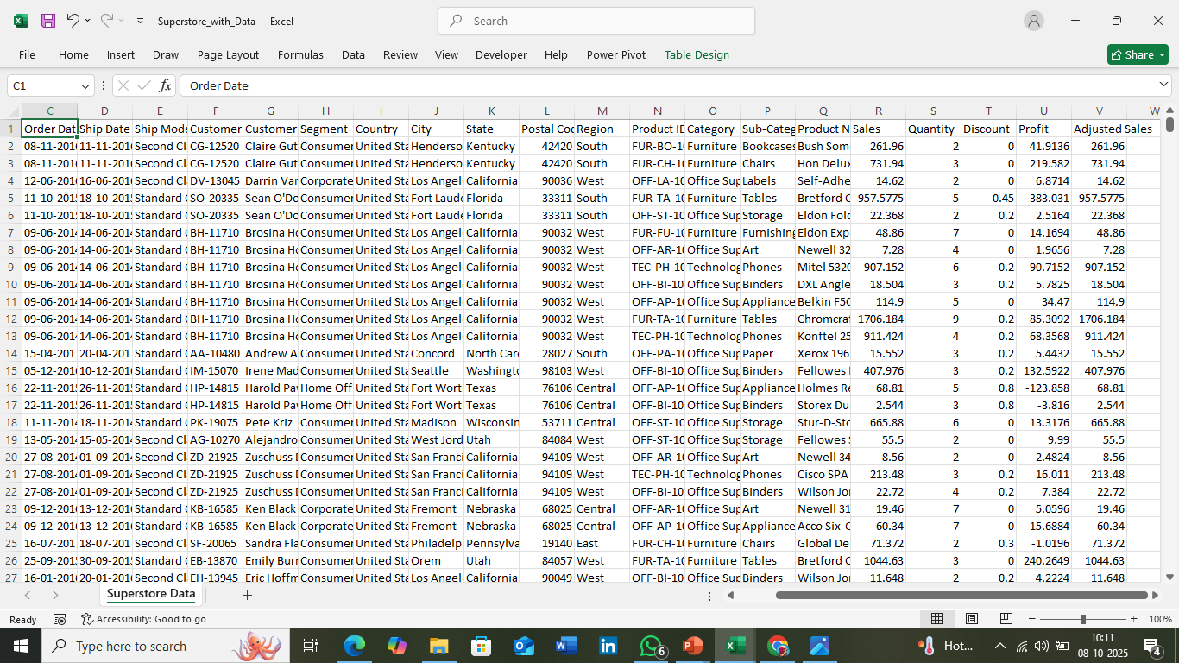
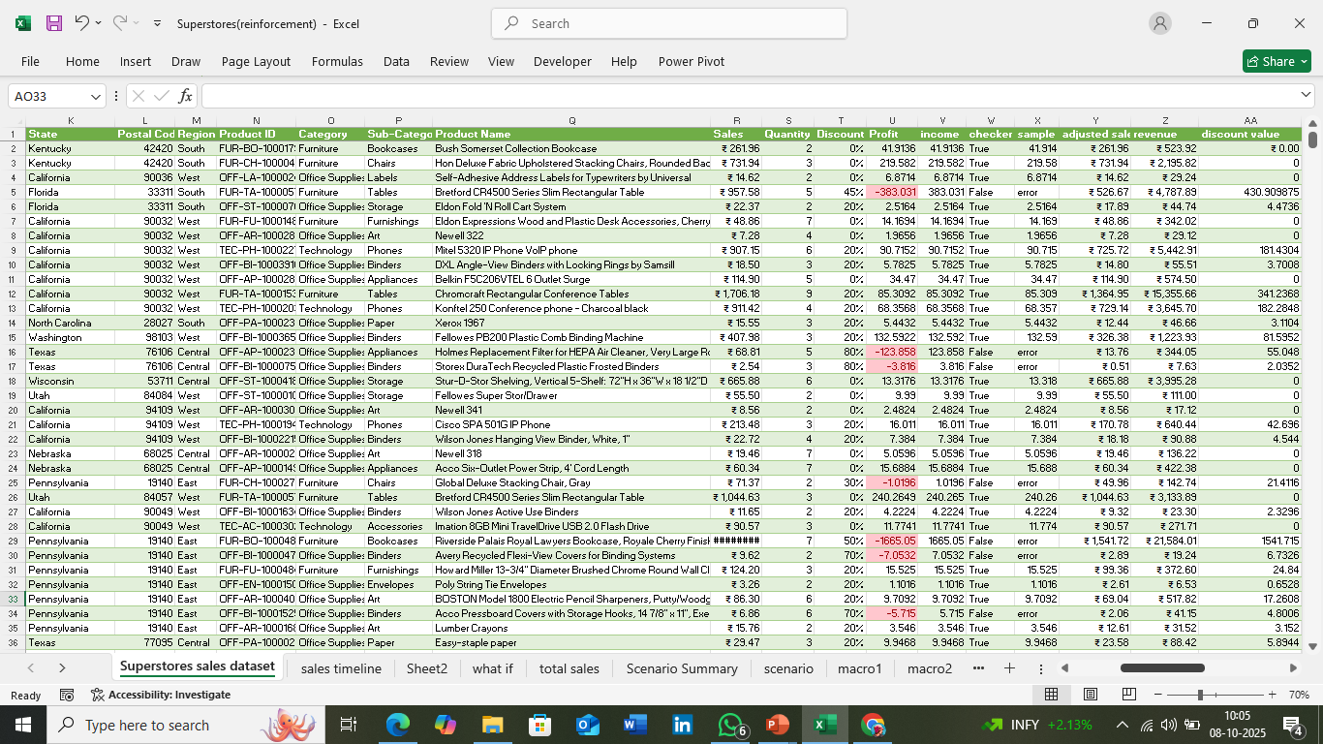
RAW DATA
CLEANED DATA

Slide 5
INSIGHTS AND RECOMMENDATIONS
Best-Performing Channels & Products:
  Standard Class had the highest sales.
  Technology products earned the most revenue.
  Office Supplies sold in high quantities.
  Furniture had fewer sales but higher order values.
Discount Trends:
  Average discount was about 15%.
  Higher discounts increased sales but reduced profit.
  Medium discounts (10–20%) worked best.
  Corporate customers got low Seasonal Patterns
  Peak sales: November–December.
  Low sales: February–April.

Slide 6
KEY METRICS CALCULATION AND DATA ANALYSIS:
TOTAL SALES:
  Gross Sales: =SUM(Sales_Amount)
  Adjusted Sales: =Net_Sales - SUM(Discount_Amount)
AVERAGE SALES PER ORDER:
  =AVERAGE(Sales_Amount) or
  =AVERAGEIF(Order_Type, “Furniture", Sales_Amount)
TOTAL DISCOUNTS:
  =SUM(Discount_Amount)/SUM(Gross_Sales)
TOP PERFORMING CATEGORIES:
  =Used Pivotchart & Table to get Values from data set to create dashboard
from another sheet

Slide 7



INSIGHTS
KEY MATRICS

Slide 8
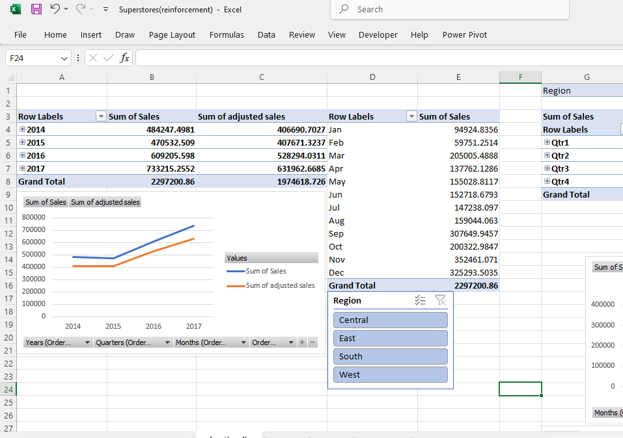
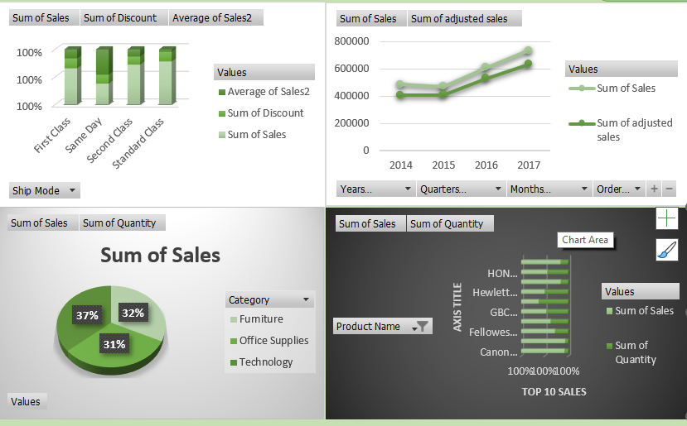
PIVOT TABLES AND PIVOT CHARTS
PivotTables were used to summarize sales by Ship Mode, Product Category, and Order Date, helping identify top-performing channels, seasonal trends, and category-wise performance for deeper, faster sales insights.

Slide 9
DASHBOARD OVERVIEW
The dashboard was designed to showcase key sales insights in a simple, interactive, and easy-to-use way. It helps stakeholders explore data in real time and make quick, informed decisions.
KEY COMPONENTS:
KPIs: The dashboard highlights key performance indicators (KPIs) such as total sales, average sales per order, top-performing product categories, and overall sales trends.
Slicer: Interactive filters for dimensions such as segment and category let users easily explore and drill down into specific data segments.

Slide 10
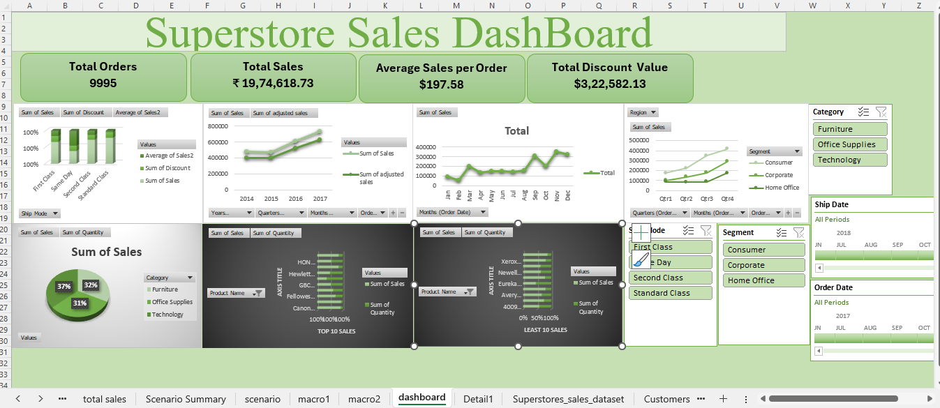
VALUES

Slide 11
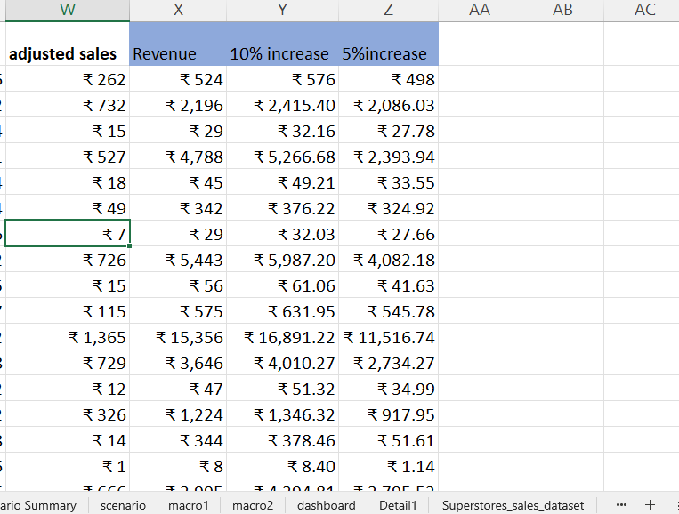
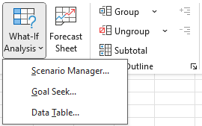
WHAT-IF ANALYSIS
A What-If Analysis was carried out to evaluate how different discount rates
affect total revenue and profit.
The results showed that while a 5% discount slightly increased sales volume with minimal impact on profit, a 10% discount led to a larger boost in sales but noticeably reduced overall profit margins.
  Net Value Calculation: =Sales* (1-Discount)*Quantity
  5% Decreased Discount: =Netvalue*(1-Discount)-0.05)
  10% Increase in sales: =Netvalue*1.1

Slide 12
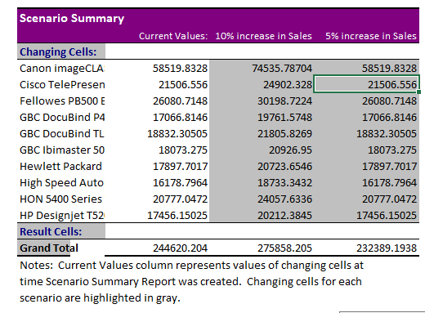
SCENARIO MANAGER
  The Scenario Summary Tool in Excel was used to compare results from different What-If scenarios. Two discount scenarios — 5% and 10% — were created using Scenario Manager.
  The summary report displayed how changes in the discount rate affected key metrics like Total Sales, Net Revenue, and Profit. This made it easier to analyze and decide which discount strategy works best.

Slide 13
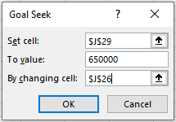
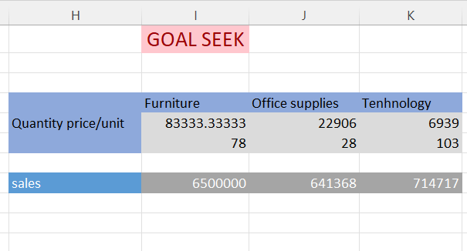
GOAL SEEK
The Goal Seek was applied to find the number of units required, based on the selling price per unit and average discount rate.
  In this analysis, default values were provided for Sales, Discount, and Quantity in the dataset.
  The Goal Seek tool was then used to determine how changes in these values affect the Net Value.
Formulas:
  Adjusted sales: =Sales * (1 - Discount) * Quantity
  Discount (5%): =Net Value * (1 - 0.05)

Slide 14
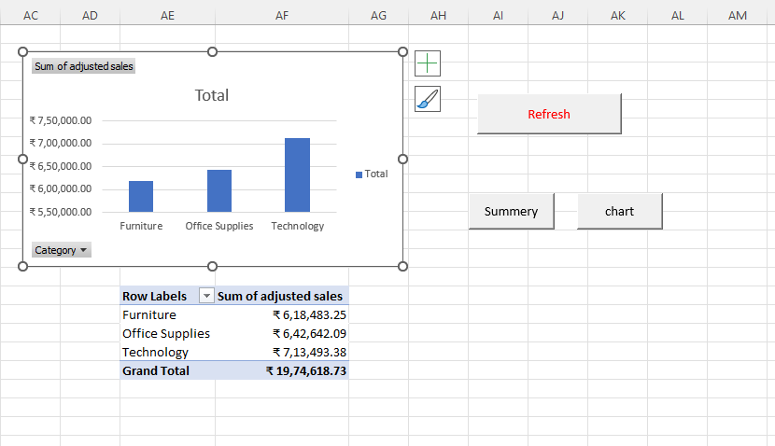
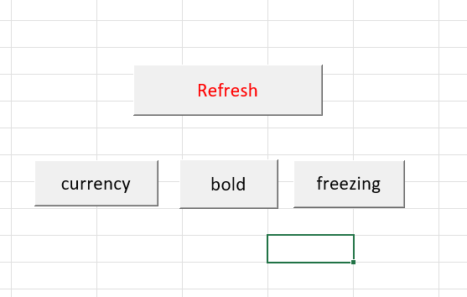
MACROS
The macros were created using the Record Macro feature to capture a sequence of actions such as:
  Applying consistent formatting (currency, borders, bold headers).
  Performing data calculations for sales, discounts, and net values.
Automatically generating or refreshing PivotTables and charts for updated reports.

Slide 15
CONCLUSION
The analysis provided insights into sales performance, product trends, and discount strategies. Online sales were the top-performing channel, and among products, Technology, Office Supplies, and Furniture contributed most to revenue. A 5% discount slightly increased sales while maintaining profits, whereas a 10% discount raised sales but reduced profit. PivotTables, PivotCharts, What-If Analysis, Goal Seek, and Macros were used to aggregate data, simulate scenarios, and automate repetitive tasks. The interactive dashboard allowed stakeholders to explore data and make informed decisions.

Slide 16
THANK YOU

